Slide 1
Retail Data Analysis Using SQL
Usama Abbasi
Data Analyst
usamahafeez.abbasi1234@gmail.com
https://github.com/usamaabbasi135

Slide 2
Objectives
Set up a retail sales database: Create and populate a retail sales database with the provided sales data.
Data Cleaning: Identify and remove any records with missing or null values.
Exploratory Data Analysis (EDA): Perform basic exploratory data analysis to understand the dataset.
Business Analysis: Use SQL to answer specific business questions and derive insights from the sales data

Slide 3
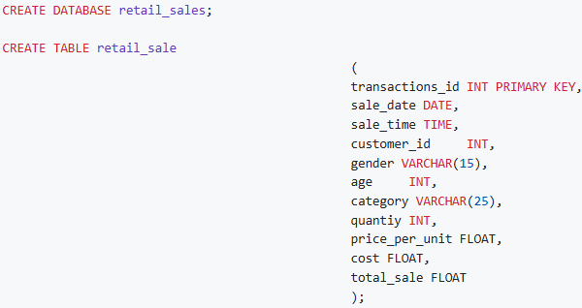
Database Setup

Slide 4
Data Exploration
Dataset: 100K+ retail transactions.
Four Fifty Unique Customers.
Three Categories.
Key Columns: transactions id, sale date, sale time, customer id, gender, age, quantity, price per unit, cost, total sale.
Tools Used: SQL (PostgreSQL).

Slide 5
Key Questions
List all the sales made on 5th November 2022.
Compare the sales of clothing in the month of November for every year.
List all the sales records where category is clothing and quantity is more than 3 in the month of November.
Calculate total orders and sales for each category.
Calculate the average age of customers who purchased items from the 'Beauty' category.
List down all transactions where sale are greater than 1000.
Calculate the total number of transaction per gender per category.
Calculate average sale for each month. Find out the best-selling month in each year.
Find top 5 customers based on the sales value.
Find number of unique customers who purchased items from each category.
Find out number of orders during each shift. (Morning <= 12 , Afternoon Between 12 & 17, Evening > 17)

Slide 6
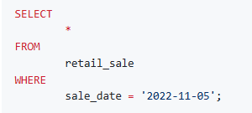
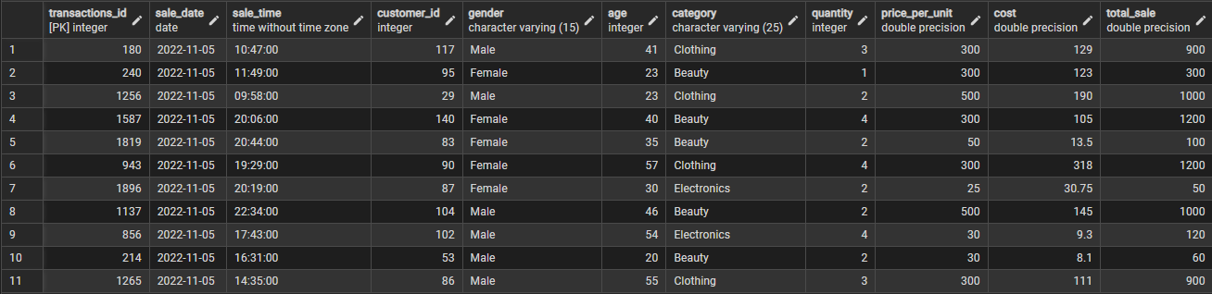
SQL QUERY AND RESULT
List all the sales made on 5th November 2022

Slide 7
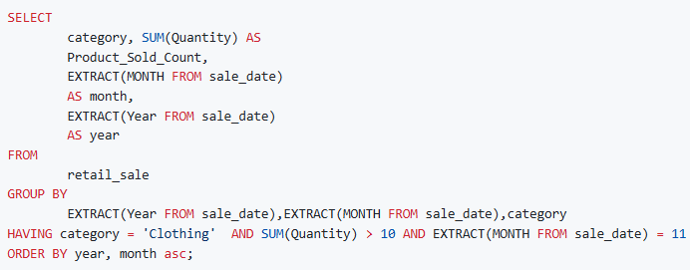

SQL QUERY AND RESULT
Compare the sales of clothing in the month of November for every year

Slide 8
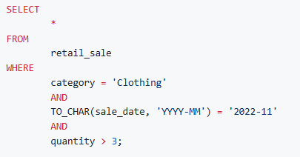
SQL QUERY AND RESULT
List all the sales records where category is clothing and quantity is more than 3 in the month of November

Slide 9
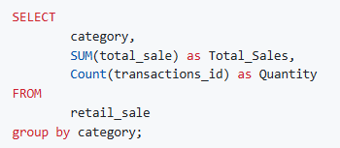
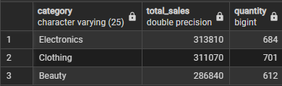
SQL QUERY AND RESULT
Calculate total orders and sales for each category

Slide 10
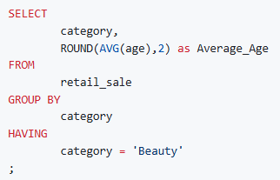

SQL QUERY AND RESULT
Calculate the average age of customers who purchased items from the 'Beauty' category

Slide 11
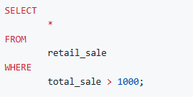
SQL QUERY AND RESULT
List down all transactions where sale are greater than 1000.

Slide 12
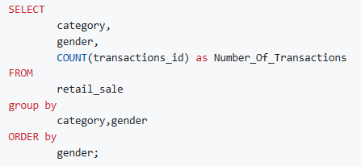
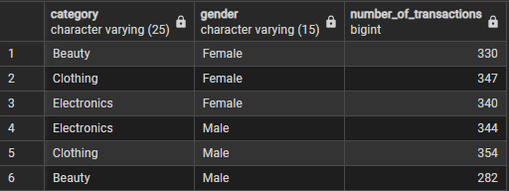
SQL QUERY AND RESULT
Calculate the total number of transaction per gender per category

Slide 13
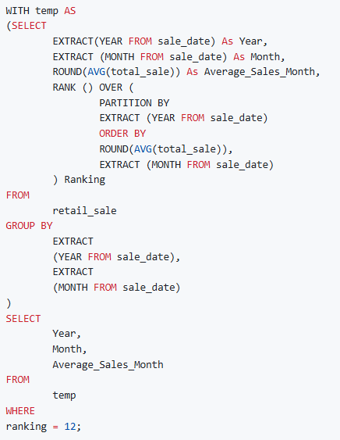

SQL QUERY AND RESULT
Calculate average sale for each month. Find out the best-selling month in each year

Slide 14
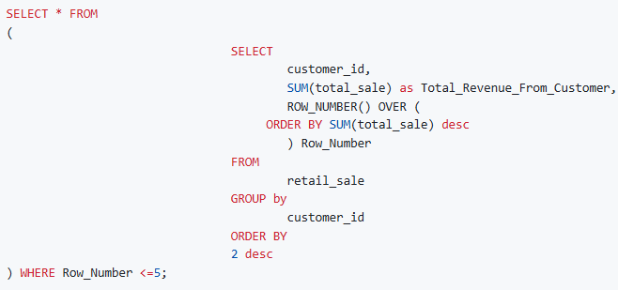
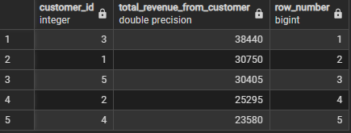
SQL QUERY AND RESULT
Find top 5 customers based on the sales value

Slide 15
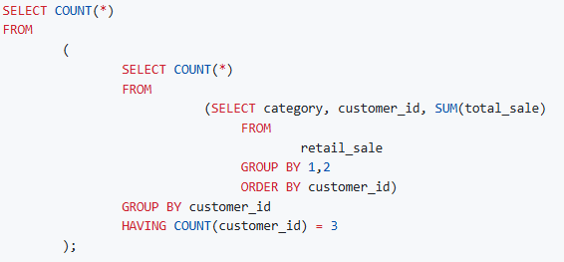

SQL QUERY AND RESULT
Find number of unique customers who purchased items from each category

Slide 16
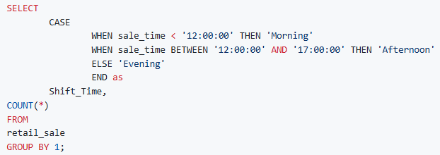
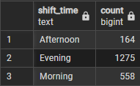
SQL QUERY AND RESULT
Find out number of orders during each shift. (Morning <= 12 , Afternoon Between 12 & 17, Evening > 17)

Slide 17
FINDINGS
Customer Demographics: The dataset includes customers from various age groups, with sales distributed across different categories such as Clothing and Beauty.
High-Value Transactions: Several transactions had a total sale amount greater than 1000, indicating premium purchases.
Sales Trends: Monthly analysis shows variations in sales, helping identify peak seasons.
Customer Insights: The analysis identifies the top-spending customers and the most popular product categories.

Slide 18
Thank you
Usama Bin Hafeez Abbasi
+92 3465293154
usamahafeez.abbasi1234@gmail.com
https://github.com/usamaabbasi135

